Slide 1
Spring 2017 CSE 101: Introduction to Computer Science & Programming Methodology
Lecture-2: Introduction to Computer Science Engineering
Dr. Md. Rashedul Islam | rashed.cse@gmail.com | www.rashedul.info
Dept. of CSE, UAP

Slide 2
What is Computer?
A computer is a programmable machine.
Computer- General-purpose device that can be programmed to carry out a set of arithmetic or logical operations automatically.
A computer is an electronic device that manipulates information, or data. It has the ability to store, retrieve, and process data based on program
Dr. Md. Rashedul Islam | rashed.cse@gmail.com | www.rashedul.info
Dept. of CSE, UAP

Slide 3
Advantages of Computer-I
High Speed
Computer is a very fast device.
It is capable of performing calculation of very large amount of data.
The computer has units of speed in microsecond, nanosecond, and even the picosecond.
It can perform millions of calculations in a few seconds as compared to man who will spend many months for doing the same task.
Accuracy
In addition to being very fast, computers are very accurate.
The calculations are 100% error free.
Computers perform all jobs with 100% accuracy provided that correct input has been given.
Storage Capability
Memory is a very important characteristic of computers.
A computer has much more storage capacity than human beings.
It can store large amount of data.
It can store any type of data such as images, videos, text, audio and many others.
Dr. Md. Rashedul Islam | rashed.cse@gmail.com | www.rashedul.info
Dept. of CSE, UAP

Slide 4
Advantages of Computer-II
Diligence
Unlike human beings, a computer is free from monotony, tiredness and lack of concentration.
It can work continuously without any error and boredom.
It can do repeated work with same speed and accuracy.
Versatility
A computer is a very versatile machine.
A computer is very flexible in performing the jobs to be done.
This machine can be used to solve the problems related to various fields.
At one instance, it may be solving a complex scientific problem and the very next moment it may be playing a card game.
Reliability
A computer is a reliable machine.
Modern electronic components have long lives.
Computers are designed to make maintenance easy.
Dr. Md. Rashedul Islam | rashed.cse@gmail.com | www.rashedul.info
Dept. of CSE, UAP

Slide 5
Advantages of Computer-III
Automation
Computer is an automatic machine.
Automation means ability to perform the given task automatically.
Once a program is given to computer i.e., stored in computer memory, the program and instruction can control the program execution without human interaction.
Reduction in Paper Work
The use of computers for data processing in an organization leads to reduction in paper work and results in speeding up a process.
As data in electronic files can be retrieved as and when required, the problem of maintenance of large number of paper files gets reduced.
Reduction in Cost
Though the initial investment for installing a computer is high but it substantially reduces the cost of each of its transaction.
Dr. Md. Rashedul Islam | rashed.cse@gmail.com | www.rashedul.info
Dept. of CSE, UAP

Slide 6
Disadvantages of Computer
No I.Q
A computer is a machine that has no intelligence to perform any task.
Each instruction has to be given to computer.
A computer cannot take any decision on its own.
Dependency
It functions as per a user’s instruction, so it is fully dependent on human being
No Feeling
Computers have no feelings or emotions.
It cannot make judgement based on feeling, taste, experience, and knowledge unlike a human being.
Dr. Md. Rashedul Islam | rashed.cse@gmail.com | www.rashedul.info
Dept. of CSE, UAP

Slide 7
Applications of Computer
Business
Banking
Insurance
Education
Communication
Marketing
Health Care
Engineering Design
Military
Government
Dr. Md. Rashedul Islam | rashed.cse@gmail.com | www.rashedul.info
Dept. of CSE, UAP

Slide 8
Human and Computer
Dr. Md. Rashedul Islam | rashed.cse@gmail.com | www.rashedul.info
Dept. of CSE, UAP

Slide 9
Calculation inside human brain
Dr. Md. Rashedul Islam | rashed.cse@gmail.com | www.rashedul.info
Dept. of CSE, UAP

Slide 10
Computer System Structure
Computer system can be divided into four components:
Hardware – provides basic computing resources
CPU, memory, I/O devices
Operating system
Controls and coordinates use of hardware among various applications and users
Application programs – define the ways in which the system resources are used to solve the computing problems of the users
Word processors, compilers, web browsers, database systems, video games
Users
People, machines, other computer
Dr. Md. Rashedul Islam | rashed.cse@gmail.com | www.rashedul.info
Dept. of CSE, UAP

Slide 11
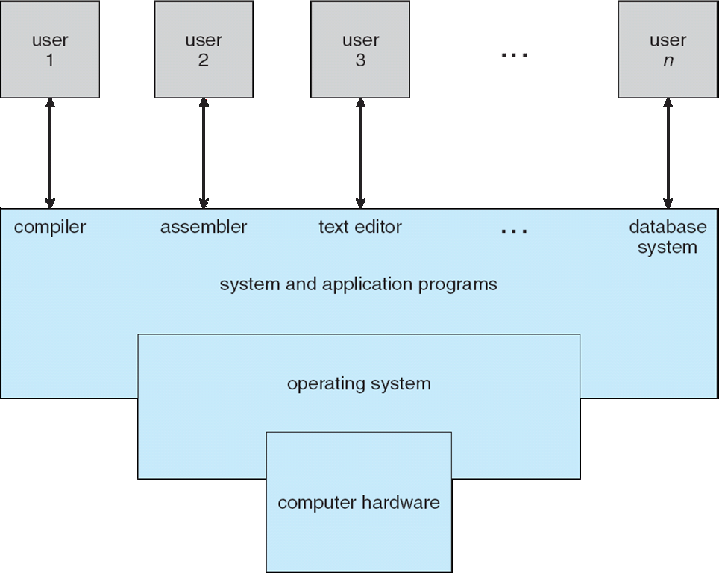
Computer System Structure
Dr. Md. Rashedul Islam | rashed.cse@gmail.com | www.rashedul.info
Dept. of CSE, UAP

Slide 12
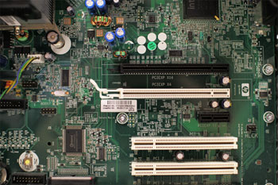
Hardware
Hardware is any part of your computer that has a physical structure, such as the keyboard or mouse.
It also includes all of the computer's internal parts, which you can see in the image below.
Dr. Md. Rashedul Islam | rashed.cse@gmail.com | www.rashedul.info
Dept. of CSE, UAP

Slide 13
Software
Software is any set of instructions that tells the hardware what to do.
It is what guides the hardware and tells it how to accomplish each task.
Some examples of software include web browsers, games, and word processors.
Dr. Md. Rashedul Islam | rashed.cse@gmail.com | www.rashedul.info
Dept. of CSE, UAP

Slide 14
What is an Operating System (System Software)?
A program that acts as an intermediary between a user of a computer and the computer hardware
Operating system goals:
Execute user programs and make solving user problems easier
Make the computer system convenient to use
Use the computer hardware in an efficient manner
An operating system is the most important software that runs on a computer.
It manages the computer's memory, processes, and all of its software and hardware.
It also allows you to communicate with the computer without knowing how to speak the computer's language.
Without an operating system, a computer is useless.
Example: Windows, MacOS X, Linux
Dr. Md. Rashedul Islam | rashed.cse@gmail.com | www.rashedul.info
Dept. of CSE, UAP

Slide 15
What is an Application Software?
An application is any program, or group of programs, that is designed for the end user.
Applications software (also called end-user programs) include such things as database programs, word processors, Web browsers and spreadsheets.
Dr. Md. Rashedul Islam | rashed.cse@gmail.com | www.rashedul.info
Dept. of CSE, UAP

